Slide 1
Dynamic UAS Traffic Volume Reservation Based on Multi-Scale A*
Jun Xiang, Ph.D. Student
Victor Amaya, Graduate Student
Jun Chen, Assistant Professor
Department of Aerospace Engineering, SDSU
AIAA SciTech Forum 2022
Copyright © 2022 Jun Xiang, Victor Amaya and Jun Chen . Published by the American Institute of Aeronautics and Astronautics, Inc., with permission.
Notes:
Hi, my name is Jun Xiang, and I will be presenting the dynamic unmanned aerial system traffic volume reservation based on Multi-Scale A*. This work was done by Victor Amaya, Dr. Chen and myself. From the department of aerospace engineering, San Diego State University.

Slide 2
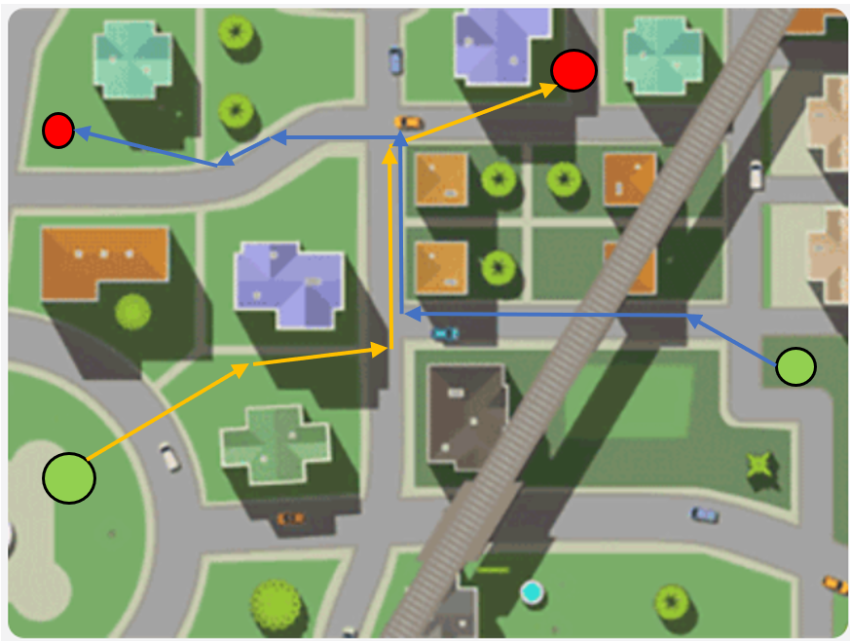

Background
Notes:
Background: the unmanned aerial vehicle becomes more and more popular. However, the airspace is limited. in the future, it is highly possible we have flights all over the neighbor.

Slide 3
Background
Notes:
Therefore, we need to increase the efficiency of the current airspace reservation system.

Slide 4
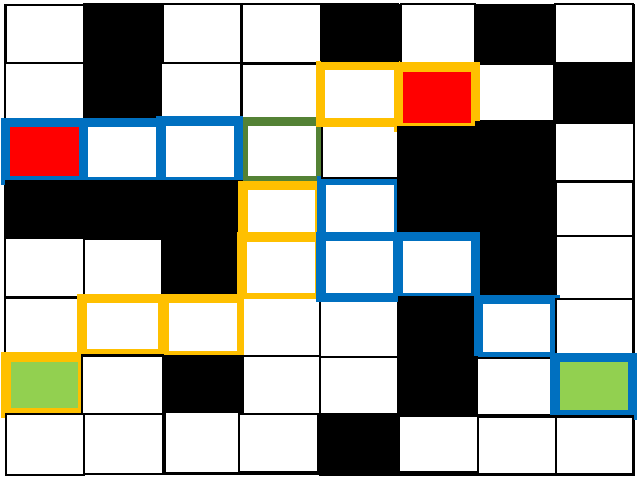
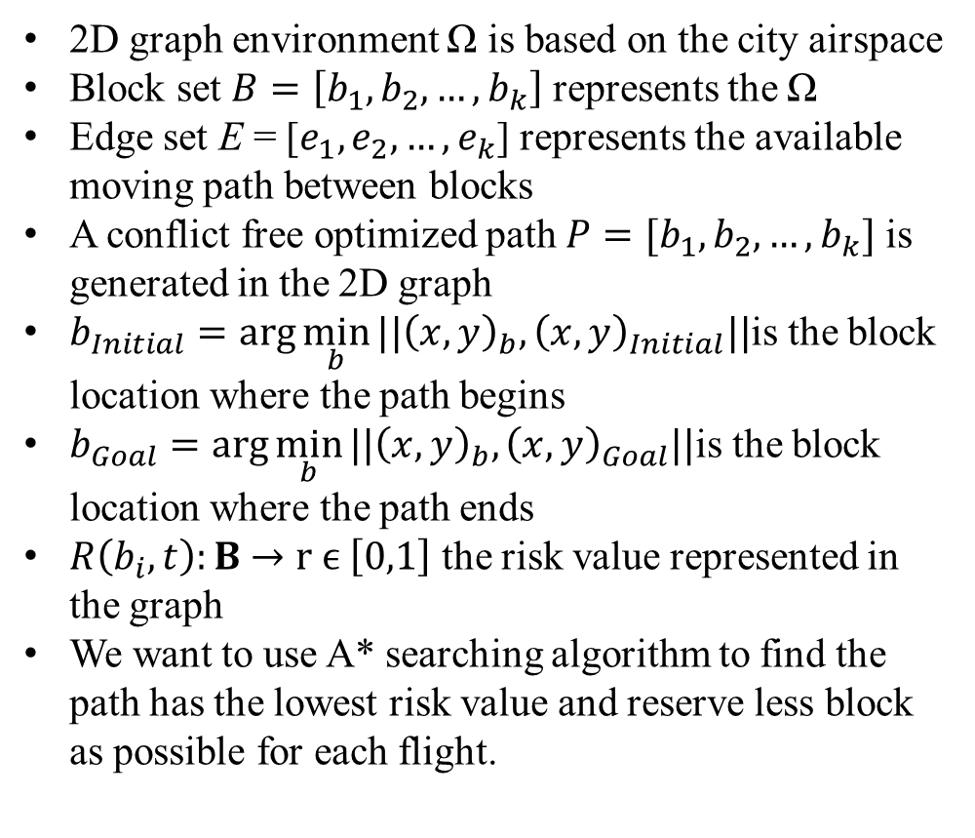
Problem Statement
2D graph environment Ω is based on the city airspace
Block set $B=\left[b_{1},b_{2},…,b_{k}\right]$ represents the Ω
Edge set E = [$e_{1},e_{2},…,e_{k}$] represents the available moving path between blocks
A conflict free optimized path $P=[b_{1},b_{2},…,b_{k}]$ is generated in the 2D graph
$b_{Initial}=\arg{\min_{b}{||{\left(x,y\right)}_{b},{\left(x,y\right)}_{Initial}||}}$is the block location where the path begins
$b_{Goal}=\arg{\min_{b}{||{\left(x,y\right)}_{b},{\left(x,y\right)}_{Goal}||}}$is the block location where the path ends
$R\left(b_{i},t\right):B$ $→r ϵ \left[0,1\right]$ the risk value represented in the graph
We want to use A* searching algorithm to find the path has the lowest risk value and reserve less block as possible for each flight.
Notes:
In our paper, to simplify the problem.
We split the environment omega into many small blocks. And we use edge e to represent the path between blocks.
Let us say we have two flights fly from the green circle to the red circle along the yellow and blue path,
They now fly from blocks to blocks like the figures below.
The path will be a set of blocks denoted by the blue and yellow-framed blocks.. And the initial and goal position becomes the nitial block and the goal block Denoted by those green and red block.
To represent the environment, each block has a binary risk value. 1 means it is dangerous and the flight should not enter it. 0 means it is safe block.
In the lower figure, the black block represents the dangerous block, and the white block represents the safe blocks.
With this block graph We want to use A* searching algorithm to fiend the path has the lowest risk value and reserve less block a s possible for each flight

Slide 5
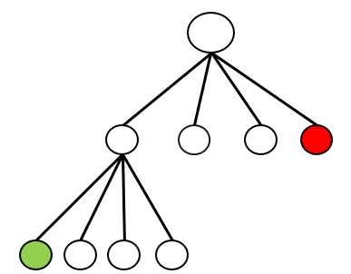
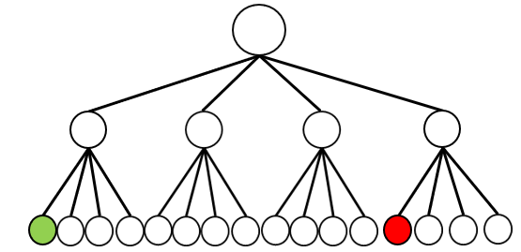
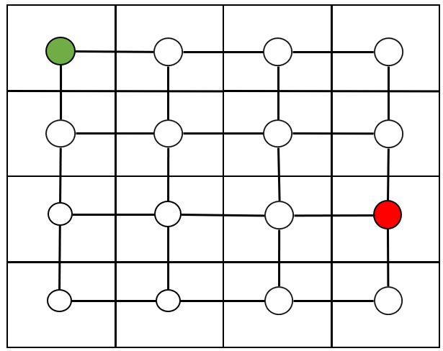
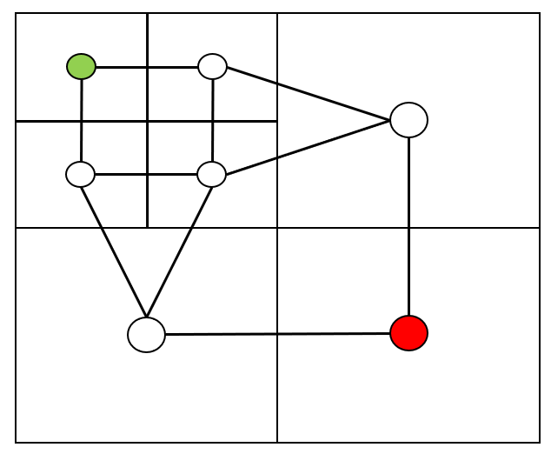
Multi-Resolution Graph with Quadtree
Full Resolution
Multi- Resolution
Notes:
However, A* is very slow r. So we need to decrease the search space
As mentioned before, we use blocks and edges to represent the environment.
We use a quadtree to manage those blocks and edges.
in the figures, the green nodes represent the green block, also the edge connects between this block and the neighbor blocks.
Similarly, the red node represents the red block and red edges.
Let us say the agent is located at the green block, and we want to decide which edge we want to choose. The nodes are relatively far from the green block, are not really important.
So we merge those small blocks into larger blocks, and decrease the number of blocks,
This is what we called a multi-resolution graph.

Slide 6
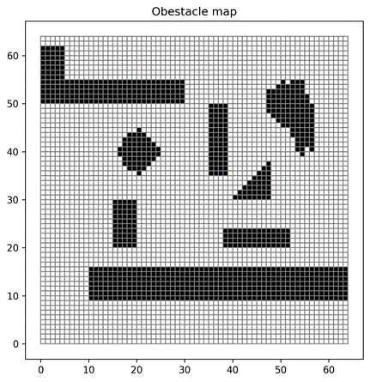
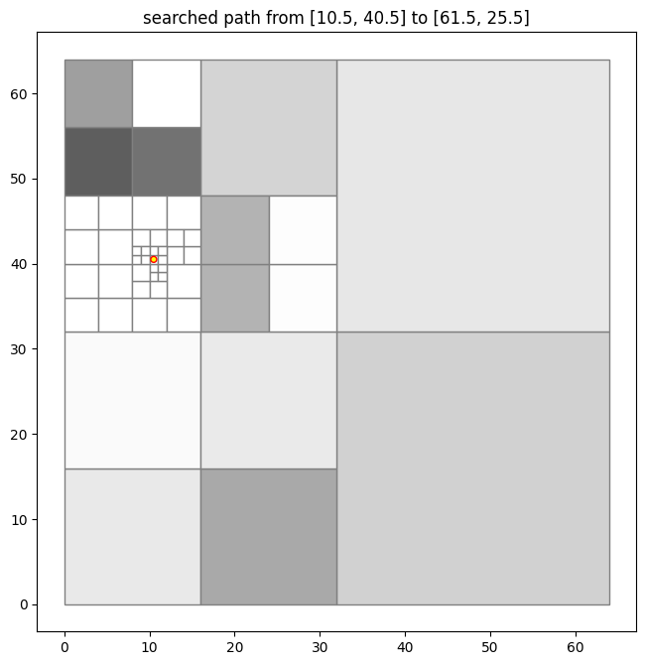
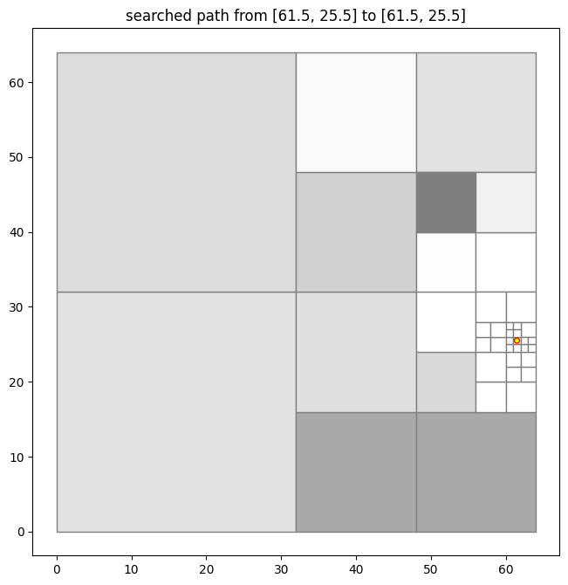
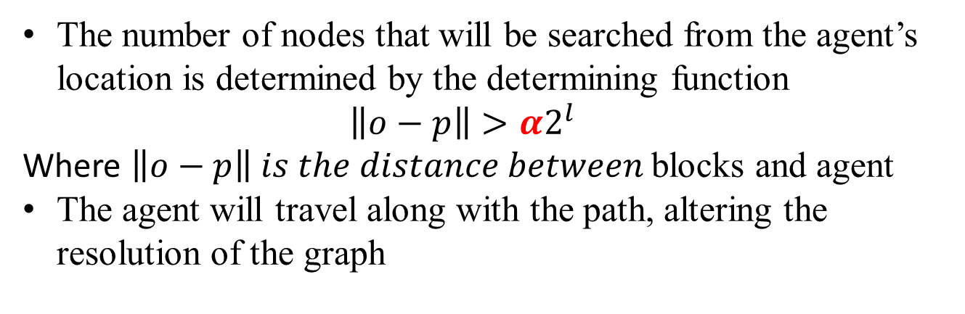
Multi-Resolution Graph Example
Grayscale represents the average risk value in a big block
Full resolution
Multi-resolution graph
The number of nodes that will be searched from the agent’s location is determined by the determining function $\left\|o−p\right\|>α2^{l}$
Where $\left\|o−p\right\| is the distance between$blocks and agent
The agent will travel along with the path, altering the resolution of the graph
Notes:
Here is an example of multi-reslolution graph
The left graph is a full-resolution map, the black blocks are the dangerous blocks, and the agent should avoid those.
The right two graphs are the multi-resolution graph. The agent is denoted by the small red circle. As shown as the figure, the blocks near the agents are finer, and the block far away from the agent is bigger. And the grayscale represents the average risk value.
A determining function is used to determine which nodes should be merged.
Generally, fewer nodes are merged near the agent and more nodes are merged on the far side.
The alpha is a very important parameter in the determining function, the larger the alpha is, the fewer nodes are merged and the resolution is higher.

Slide 7
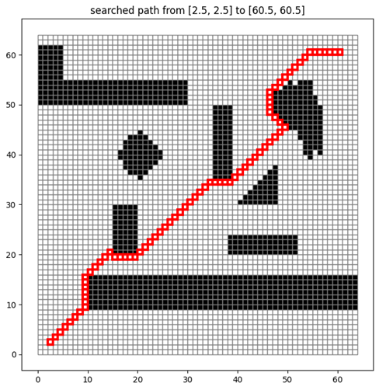
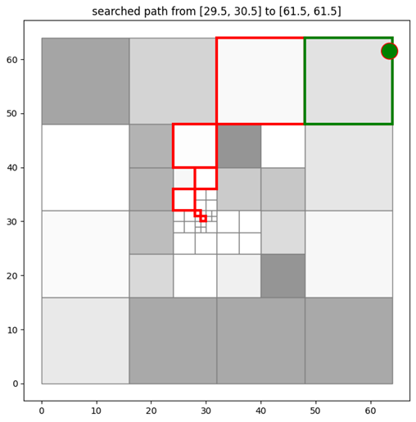
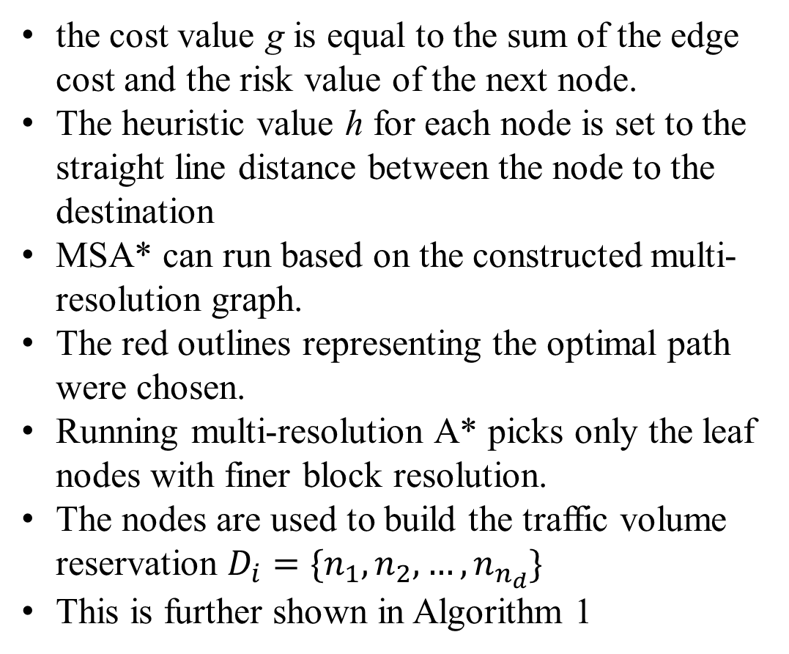
Multi-Scale A*(MSA*)
the cost value g is equal to the sum of the edge cost and the risk value of the next node.
The heuristic value h for each node is set to the straight line distance between the node to the destination
MSA* can run based on the constructed multi-resolution graph.
The red outlines representing the optimal path were chosen.
Running multi-resolution A* picks only the leaf nodes with finer block resolution.
The nodes are used to build the traffic volume reservation $D_{i}=\{n_{1},n_{2},…,n_{n_{d}}\}$
This is further shown in Algorithm 1
A* in a full resolution map
MSA* in a multi-resolution graph
Notes:
With the graph, we can search the desired path with A* star.
In this paper, we call the A* searching in a full resolution map, simple A*, we call the A* searching in the multi-resolution graph MSA*.
the cost value will be the sum of the edge cost and the risk value of the next node
The heuristic value is the straight line distance between the node to the destination
The upper figure shows an example of A star search in a full resolution map, and the lower figure shows an example of MSA star search in a multi-resolution graph.
The red outlines represents the optimal path found by A*star.

Slide 8
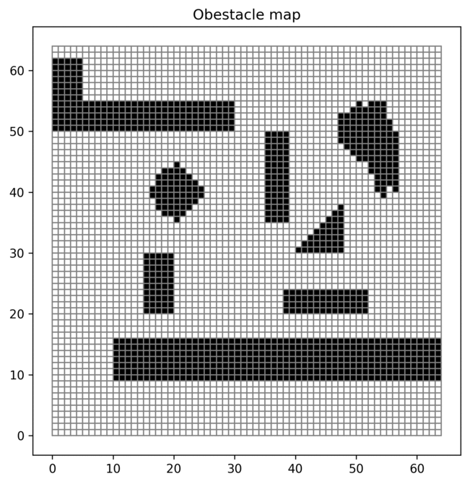
Step by Step Search and Reserve
Notes:
Because multi-scale A star is very fast, it is possible to search path step-by-step.
The agent can move one block along the founded path, reserve only few blocks, and then search the path again based on the new graph.

Slide 9
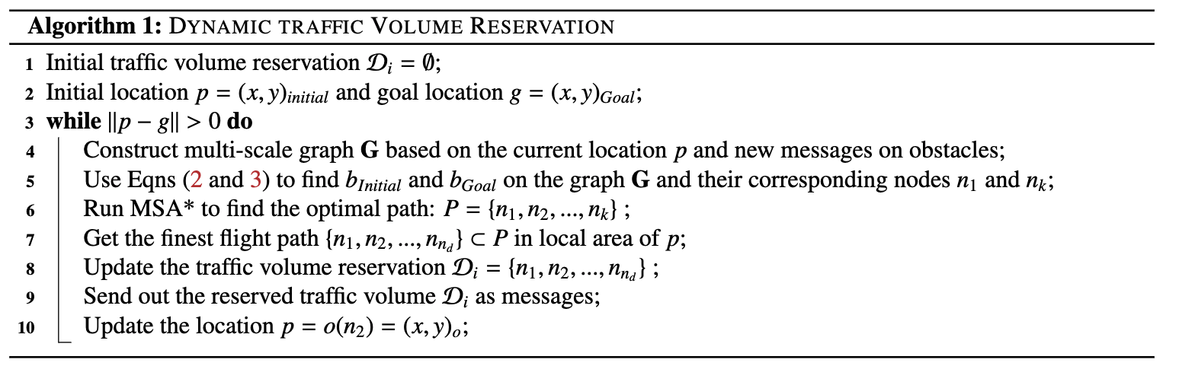
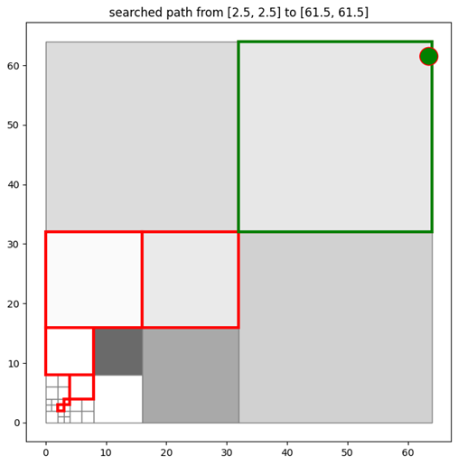
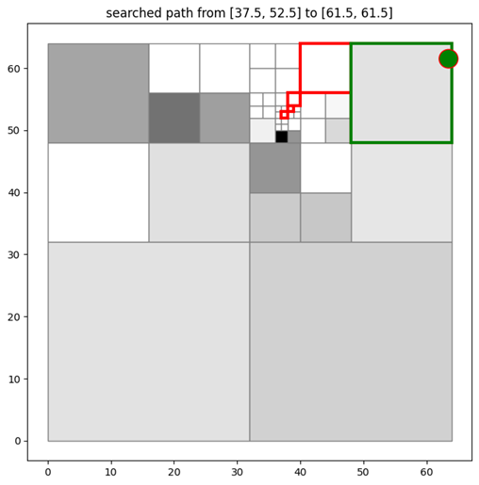
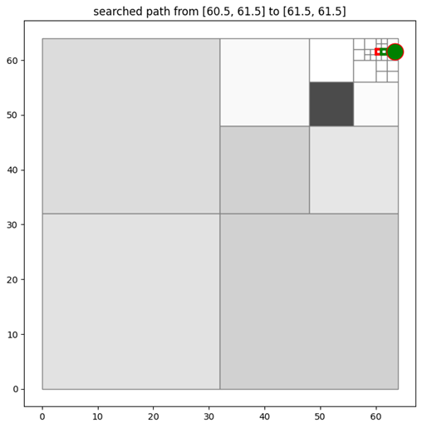
Dynamic UAS Traffic Volume Reservation
Notes:
Here is our reservation algorithm.
Until the agent reaches its destination.
It constructs a multi-resolution graph,
defines the initial block and the goal block,
runs MSA* to find the optimal path from the initial block to the goal block.
Then, it reserve the nodes in the front of the path.
After the reservation, the agent moves along the path to the next node and repeats the previous processes.

Slide 10
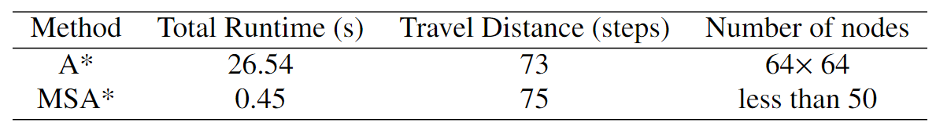
Results: A* vs. Multi-Resolution A*
MSA* is considerably faster
MSA* has a slight longer distance for A*.
Notes:
For the step by step search example, the total search time is only 0.45 while A* costs 26 seconds in the same map.
We expect that MSA is considerably faster than simple A*.
To prove that
We test both A* and MSA* in the simulated city airspace. For each case, we test 10 different maps. We use travel distance to evaluate the optimization of the found path.

Slide 11
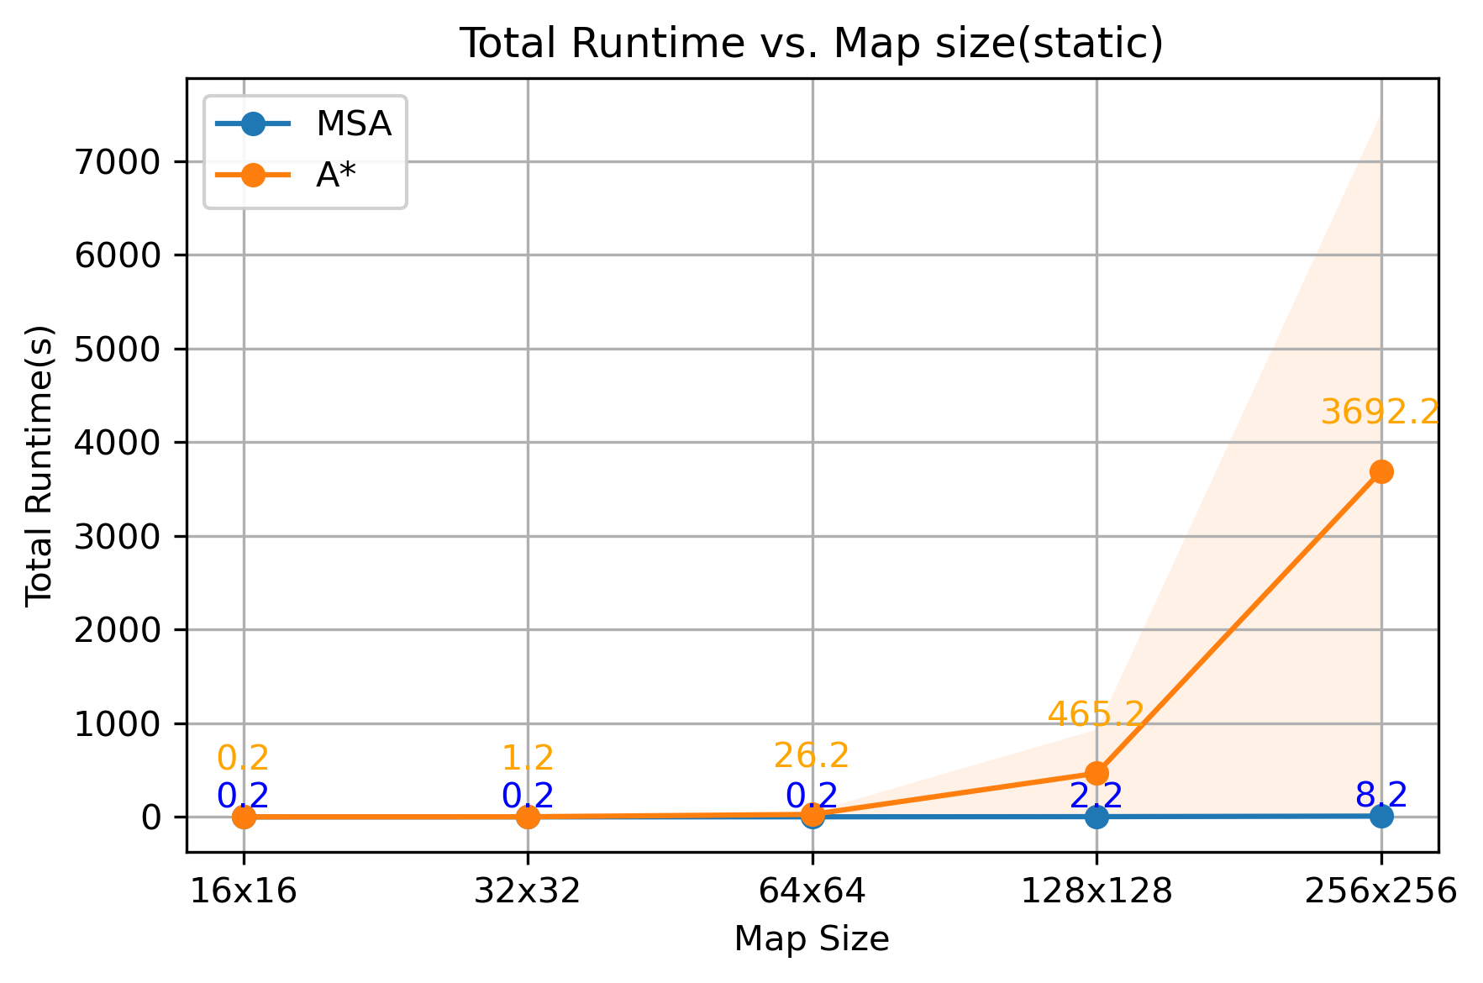
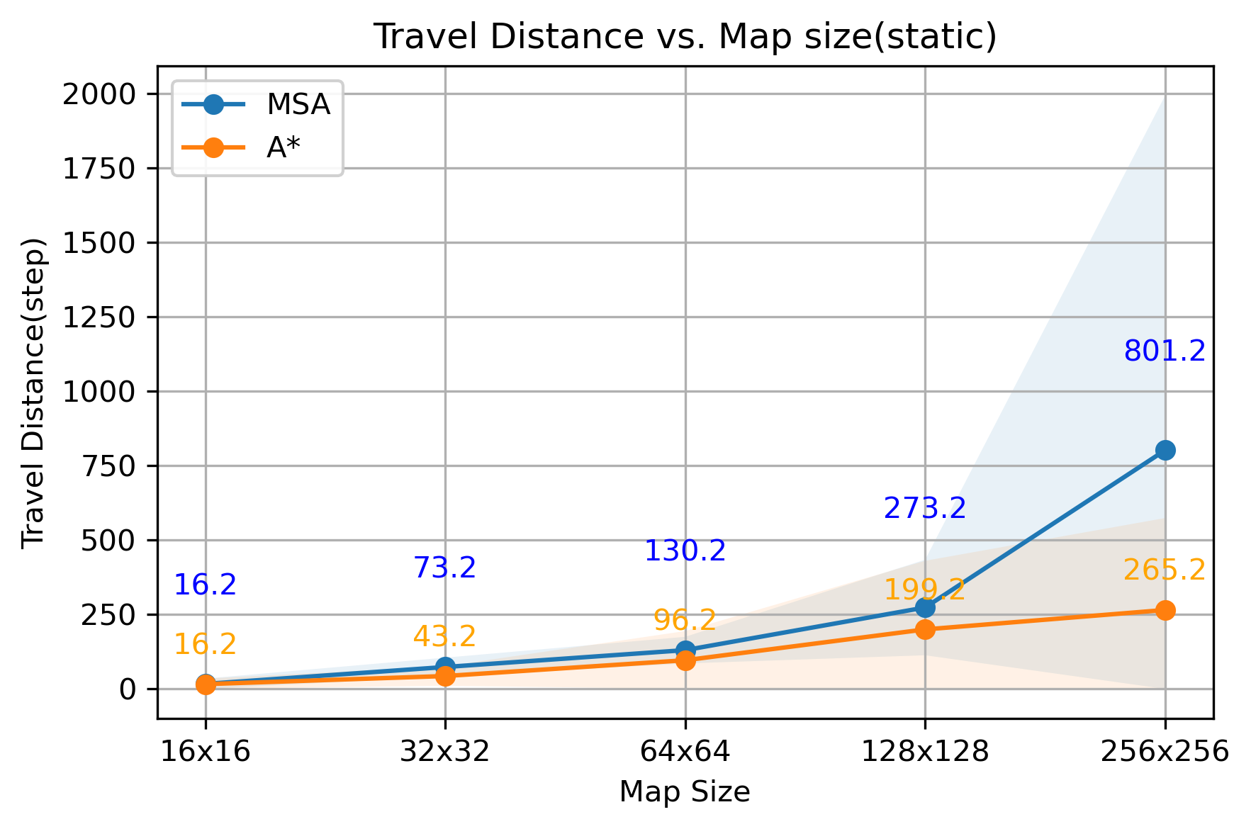
Results: Varying Map Size
Notes:
We first test them in different map size. We found out that when map size is small, the runtime is both small. However, with map size increase, the A* searching time increase exponentially, while MSA only increase a little.
However, the travel distance of the path MSA found is higher.
So, if we can increase the resolution, we may decrease the travel distance.

Slide 12
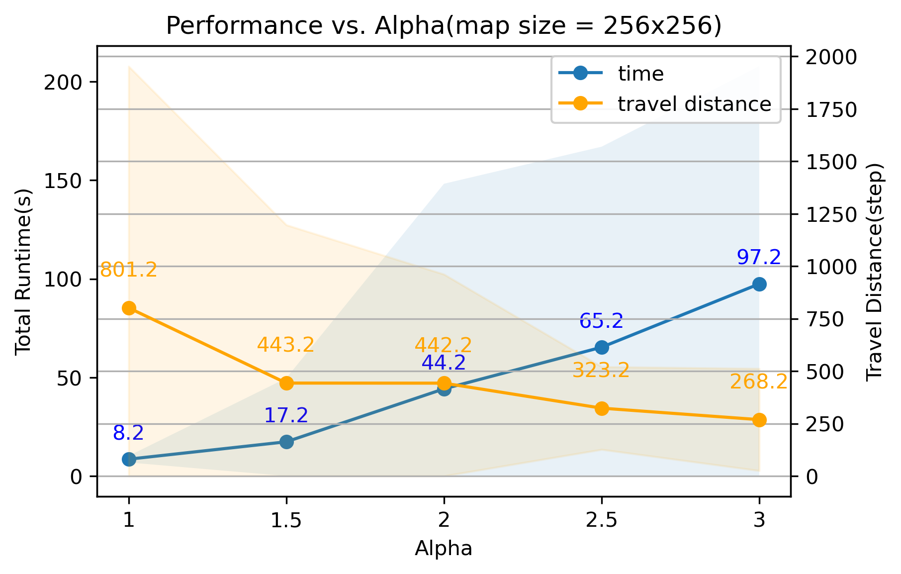
Results: Varying Explore Distance
Results of running MSA* in the complete 256x256 grid environment
Varying alpha determines the search distance of the algorithm
The larger the search distance, the shorter the runtime becomes.
Notes:
We found out that increased alpha will increase the running time but decrease the travel distance of path. When we use 3 as alpha, the travel distance decrease to 268.2, which is very close to the optimized path. While the total runtime is only 97.2 seconds, which is still very small compared to the simple A*

Slide 13
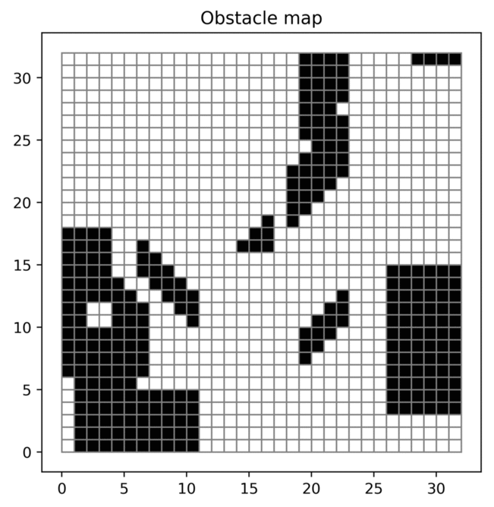
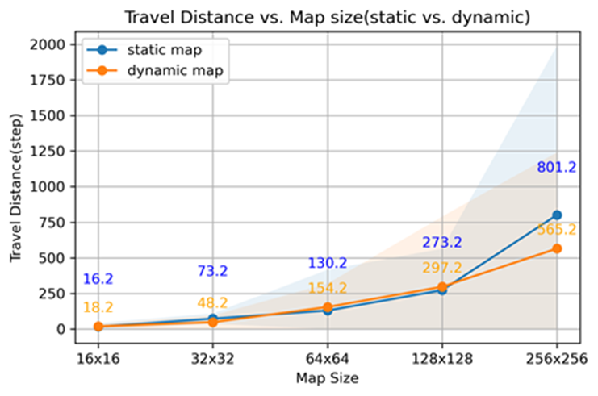
Results: Dynamic Obstacles
MSA* can successfully run in a dynamic map,
Gray represents the dynamic obstacle; red is the reserved finest block.
The difference in travel distance to reach its goal state in a dynamic map is negligible to the travel distance static map
Notes:
We also test the MSA* in dynamic environment. The experiences show that the agent moving with MSA*, can reach the destination and avoid the moving obstacle.

Slide 14
Conclusion and Future Implementation
Conclusion:
drastically shortening the A* algorithm’s run time.
Make real-time path-planning and reservation possible
Future:
This concept can further be implemented in a 3D real time city with high density air traffic
Notes:
The proposed method can drastically shorten the A* algorithm’s run time and makes real-time path-planning and reservation possible
In the future, we would like to implement this method in a 3D real-time city with high density air traffic.

Slide 15
jxiang9143@sdsu.edu Vamaya@sdsu.edu Jun.Chen@sdsu.edu

